Slide 1
Supplemental table 1. Selected genome-wide genetic study references.
First author | PMID | Cell lines | Method | Inclusion Threshold | # of hits | Included in Machine Learning?
Sack, LM | 29576454 | Pancreatic, breast, fibroblast | ORF library | Log2fc < -1 & FDR < 0.05 in either cell line | 40 | Yes
Wang, T | 28162770 | 14 human AML | CRISPRko | CS > 1 in any cell line | 6 | Yes
Wallace, J | 27081855 | MV411 AML | GeCKO CRISPRi | p < 0.05 and log2fc > 1 | 21 | No
Horlbeck, MA | 27661255 | K562 AML | CRISPRi & CRISPRa | CRISPRa p < 0.05; CRISPRa CS < 0; excluding significant negative CRISPRi | 62 | Yes
Bakke, J | 30898113 | PANC-1 pancreatic | CRISPRko | p < 0.05 | 43 | Yes
Sanson, KR | 30575746 | A375 melanoma, HT29 colorectal | CRISPRko, CRISPRi, CRISPRa | CRISPRa CS < 0, p < 0.05 | 34 | Yes
Martincorena, I | 29056346 | 7,664 tumors across 29 cancers | Molecular evolution | AML p < 0.05 or combined(all cancers) p < 0.05 | 9 | No
Wang, T | 26472758 | KBM7, K562 AML; Raji, Jiyoye lymphoma | CRISPRko & gene trap | CS > 0.5 or gene trap ratio > 0.6 | 28 | Yes
Blomen, VA | 26472760 | KBM7-HAP1 CML | Gene trap | gene trap ratio > 0.6 in both cell lines | 10 | Yes
Gilbert, LA | 25307932 | K562 AML | CRISPRi & CRISPRa | CRISPRa CS < 0; 2 stddev below mean | 21 | Yes
Davoli, T | 24183448 | 8,200 tumors 20 cancers | Mutation analysis | p < 0.05 | 40 | Yes
Sondka, Z | 30293088 | Curated catalogue | Cancer Gene Census | Tier 1 or Tier 2 Tumor Suppressor | 37 | Yes
Bold outline = “Prime” dataset where all genes meeting threshold were included.
CS = CRISPR score, the average log2 fold-change after gene targeting

Slide 2
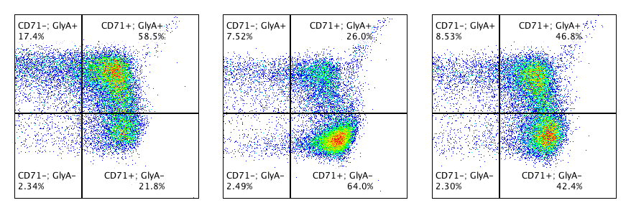
A.
gAAVS1
gGATA1
gAAVS1
gPTEN
B.
C.
GATA1
PTEN
β-actin
β-actin
D.
Erythroid differentiation progression
E.
gAAVS1
gGATA1
gPTEN
F.
Mature erythroid
GlyA
GlyA
Non-
erythroid
Immature
erythroid
CD71
CD71
Supplemental Figure 1
Notes:
Supp. Figure 1. Validation of experimental positive controls. (A) Representative western blot of positive control protein knockdown after transfection with sgRNAs. β-actin loading control. (B) Editing efficiency of control sgRNAs, n = 8. (C) Proliferation time course normalized to AAVS1. Significance determined by RM 2-way ANOVA with Geisser-Greenhouse correction and Dunnett’s multiple comparisons test, n = 6. (D) AAVS1 normalized erythroid differentiation after 14 days in culture. Significance determined by paired t-test, n = 6. (E) Representative flow plots of 14-day erythroid differentiation cultures with positive control sgRNAs.

Slide 3
Supplemental Figure 1. Validation of experimental positive controls. (A) Representative western blot of positive control protein knockdown in human CD34+ HSPCs after transfection with gRNAs. β-actin loading control. (B) Editing efficiency of control gRNAs, n = 8. (C) Proliferation time course normalized to gAAVS1. Significance determined by Dunnett’s multiple comparisons test, n = 6. (D) Progression of erythroid differentiation through expression of CD71 and Glycophorin A (GlyA). (E) Representative flow plots of day 14 erythroid differentiation cultures with positive control gRNAs. (F) Erythroid differentiation after 14 days in culture, expressed as fraction of mature erythroid/total erythroid normalized to gAAVS1. Significance determined by paired t-test, n = 6.

Slide 4
A.
B.
Supplemental Figure 1
Notes:
Supp. Figure 2. Genes in high proliferation group show expansion of edited cells. Genes were evenly split into low, mid, and high groups based on AAVS1 normalized proliferation. Change in the percentage of edited alleles before and after expansion in 7-day proliferation culture, significance determined by One-way ANOVA and Tukey’s multiple comparisons test.

Slide 5
Supplemental Figure 2. Genes in high proliferation group show expansion of edited cells. Genes were evenly split into low, mid, and high groups based on AAVS1 normalized proliferation. (A) Initial editing of each group, showing no editing bias before proliferation assay in two replicate arrays. (B) Change in the percentage of edited alleles before and after expansion in 7-day proliferation culture. Significance determined by One-way ANOVA and Tukey’s multiple comparisons test, p < 0.05.

Slide 6
Supplemental Figure 3
Notes:
Supp. Figure 3. Proliferation assay time course. Proliferation time course normalized to AAVS1 on day 3 (first measurement). n=167.

Slide 7
Supplemental Figure 3. Proliferation assay time course. Proliferation time course normalized to gAAVS1 on day 3 (first measurement). n=167 biological samples.

Slide 8
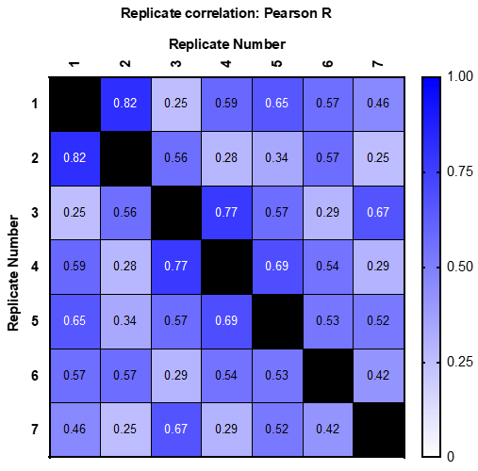
Supplemental Figure 4
Notes:
Supp. Figure 4. Correlation of proliferation assay replicates. Heat map of Pearson r correlation coefficients for each biological replicate.

Slide 9
Supplemental Figure 4. Correlation of proliferation assay biological replicates. Heat map of Pearson R correlation coefficients for each biological replicate compared against each other. Each replicate represents an array with different configurations of gRNAs, so that each gene was tested 3-4 times.

Slide 10
Supplemental Figure 5

Slide 11
Supplemental Figure 5. Correlation of proliferation assay technical replicates. Pearson R correlation coefficients for two technical replicates within each biological replicate. Each technical replicate contains two assay replicates.

Slide 12
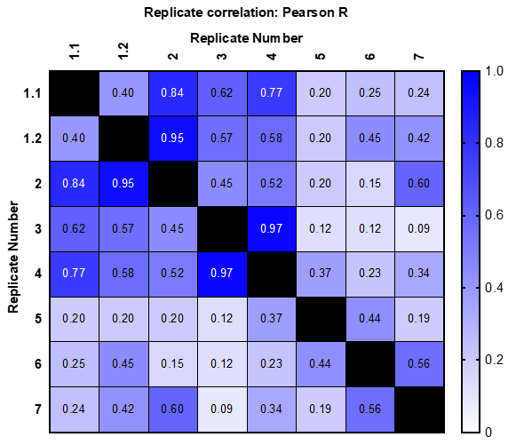
Supplemental Figure 6

Slide 13
Supplemental Figure 6. Correlation of erythroid differentiation assay biological replicates. Heat map of Pearson R correlation coefficients for each biological replicate compared against each other. Each replicate represents an array with different configurations of gRNAs, so that each gene was tested 3-4 times. Replicates 1.1 and 1.2 are repeated runs of the same configuration.

Slide 14
A.
B.
Supplemental Figure 7

Slide 15
Supplemental Figure 7. Genes included in arrayed screen are overall enriched for tumor suppressor activity. Frequency distribution of (A) proliferation normalized to gAAVS1 or (B) combined score for all edited genes. Significance of the median increase over gAAVS1 control determined by Wilcoxon signed-rank test, p < 0.05 n = 108.

Slide 16
Training Data (all non-Chr7 genes)
Performance assessment
Data-preprocessing and filtering
“Ground Truth”
100 iterations of testing, each gene scored by number of tumor suppressor identifications (0-100)
Tumor suppressor as labeled by Cancer Gene Census
Variables from 24 cell lines in 8 studies
Impute missing data
Training and test data split by bootstrapping
Hyperparameter tuning
Testing using Random Forest on Chr7 genes
Mutational signature data from Davoli et al., 2013
Supplemental Figure 8

Slide 17
Supplemental Figure 8. Design of machine learning tumor suppressor classification. Flow chart depicting design of random forest machine learning model for prediction of chromosome 7 tumor suppressor genes.

Slide 18
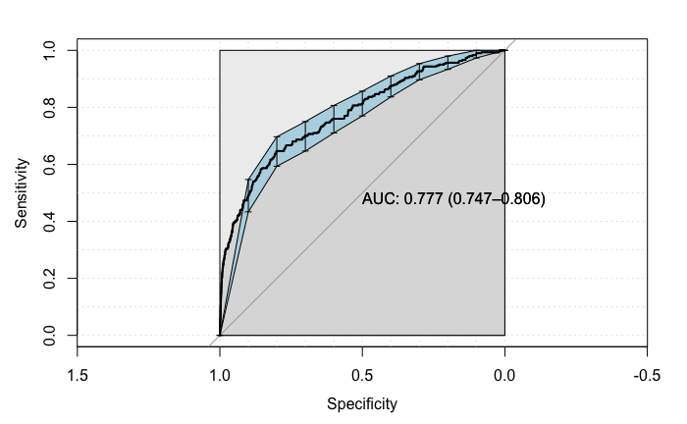
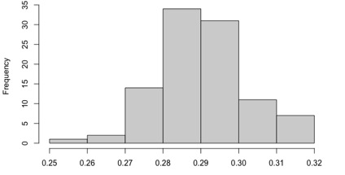
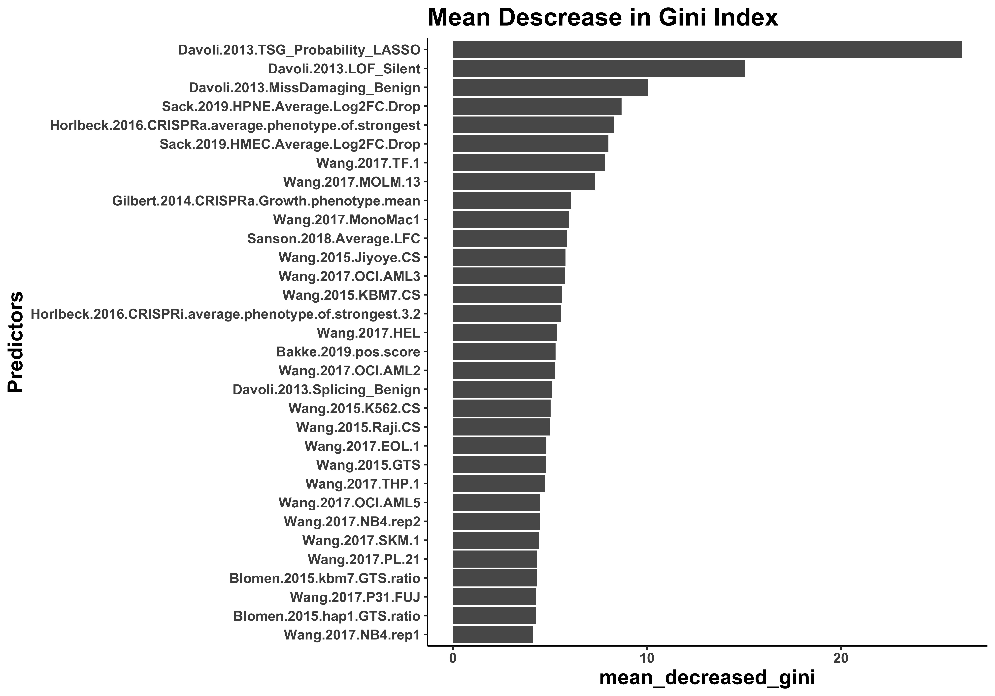
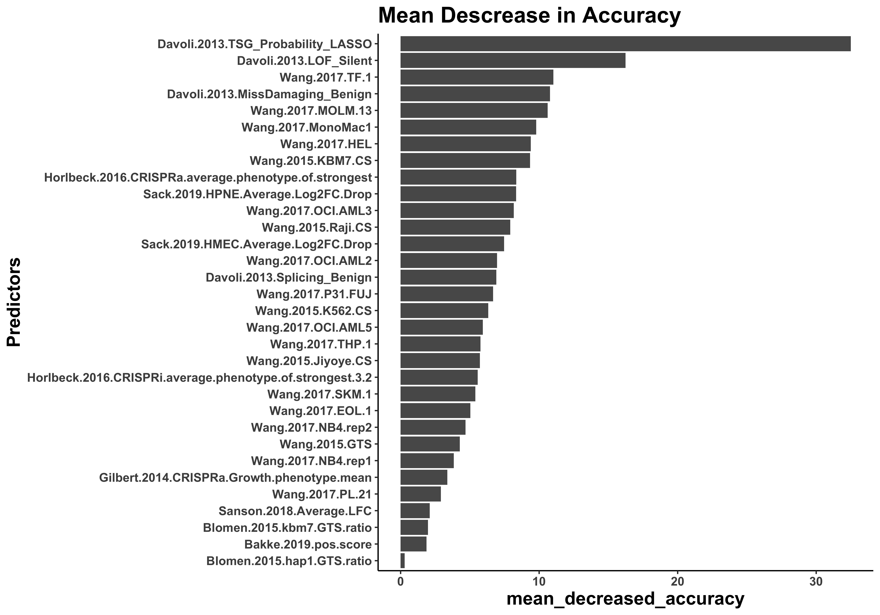
A.
B.
Out-of-bag (OOB) error rate
C.
Mean Decrease in Gini index
D.
Mean Decrease in Accuracy
Supplemental Figure 9

Slide 19
Supplemental Figure 9. Quality control measures for machine learning model. (A) AUC (Area Under The Curve) ROC (Receiver Operating Characteristics) curve. Error bar represents 90% CI. (B) Out-of-bag (OOB) error rate frequency distribution, representing the distribution of OOB error rate of 100 bootstraps of the random forest model. mean = 0.290, n=100. Represents the average error for each iteration using predictions from the trees that do not contain it within their respective bootstrap sample. (C,D) Importance of classification variables across 100 bootstrap iterations. Each classification variable is defined by the technology, cell line/mutation signature, and reference(Author.year)

Slide 20
Z-score
Supplemental Figure 10

Slide 21
Supplemental Figure 10. Heat map of variables used to consider myeloid TSG status in all genes included in experimental analysis. Genes are ranked by experimental combined score, machine learning score, and CDR status equally weighted. Columns 1 and 2 are binary variables where yellow = yes and purple = no; the remaining columns are z-scores of the experimental and machine learning classification variables.

